Slide 1
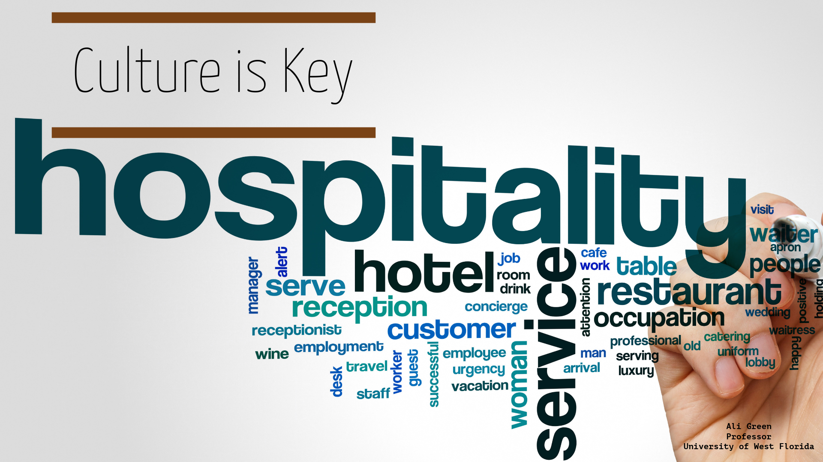

Slide 2
Goals
Culture, why is it important for our students to understand?
Defining Culture
Applying the concept to real life
Ability to apply to the classroom

Slide 3
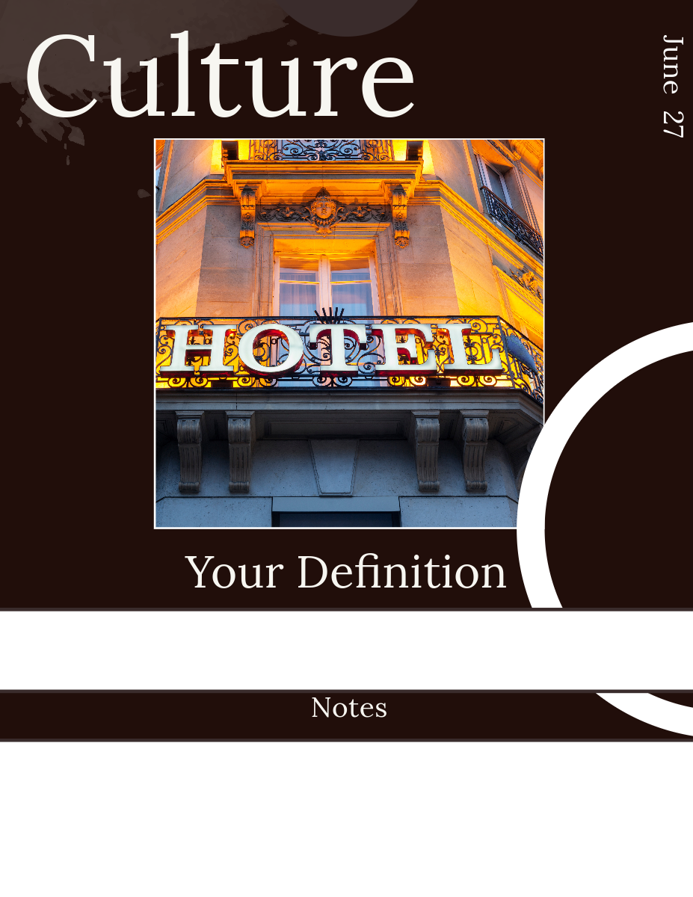
How do YOU define culture?

Slide 4
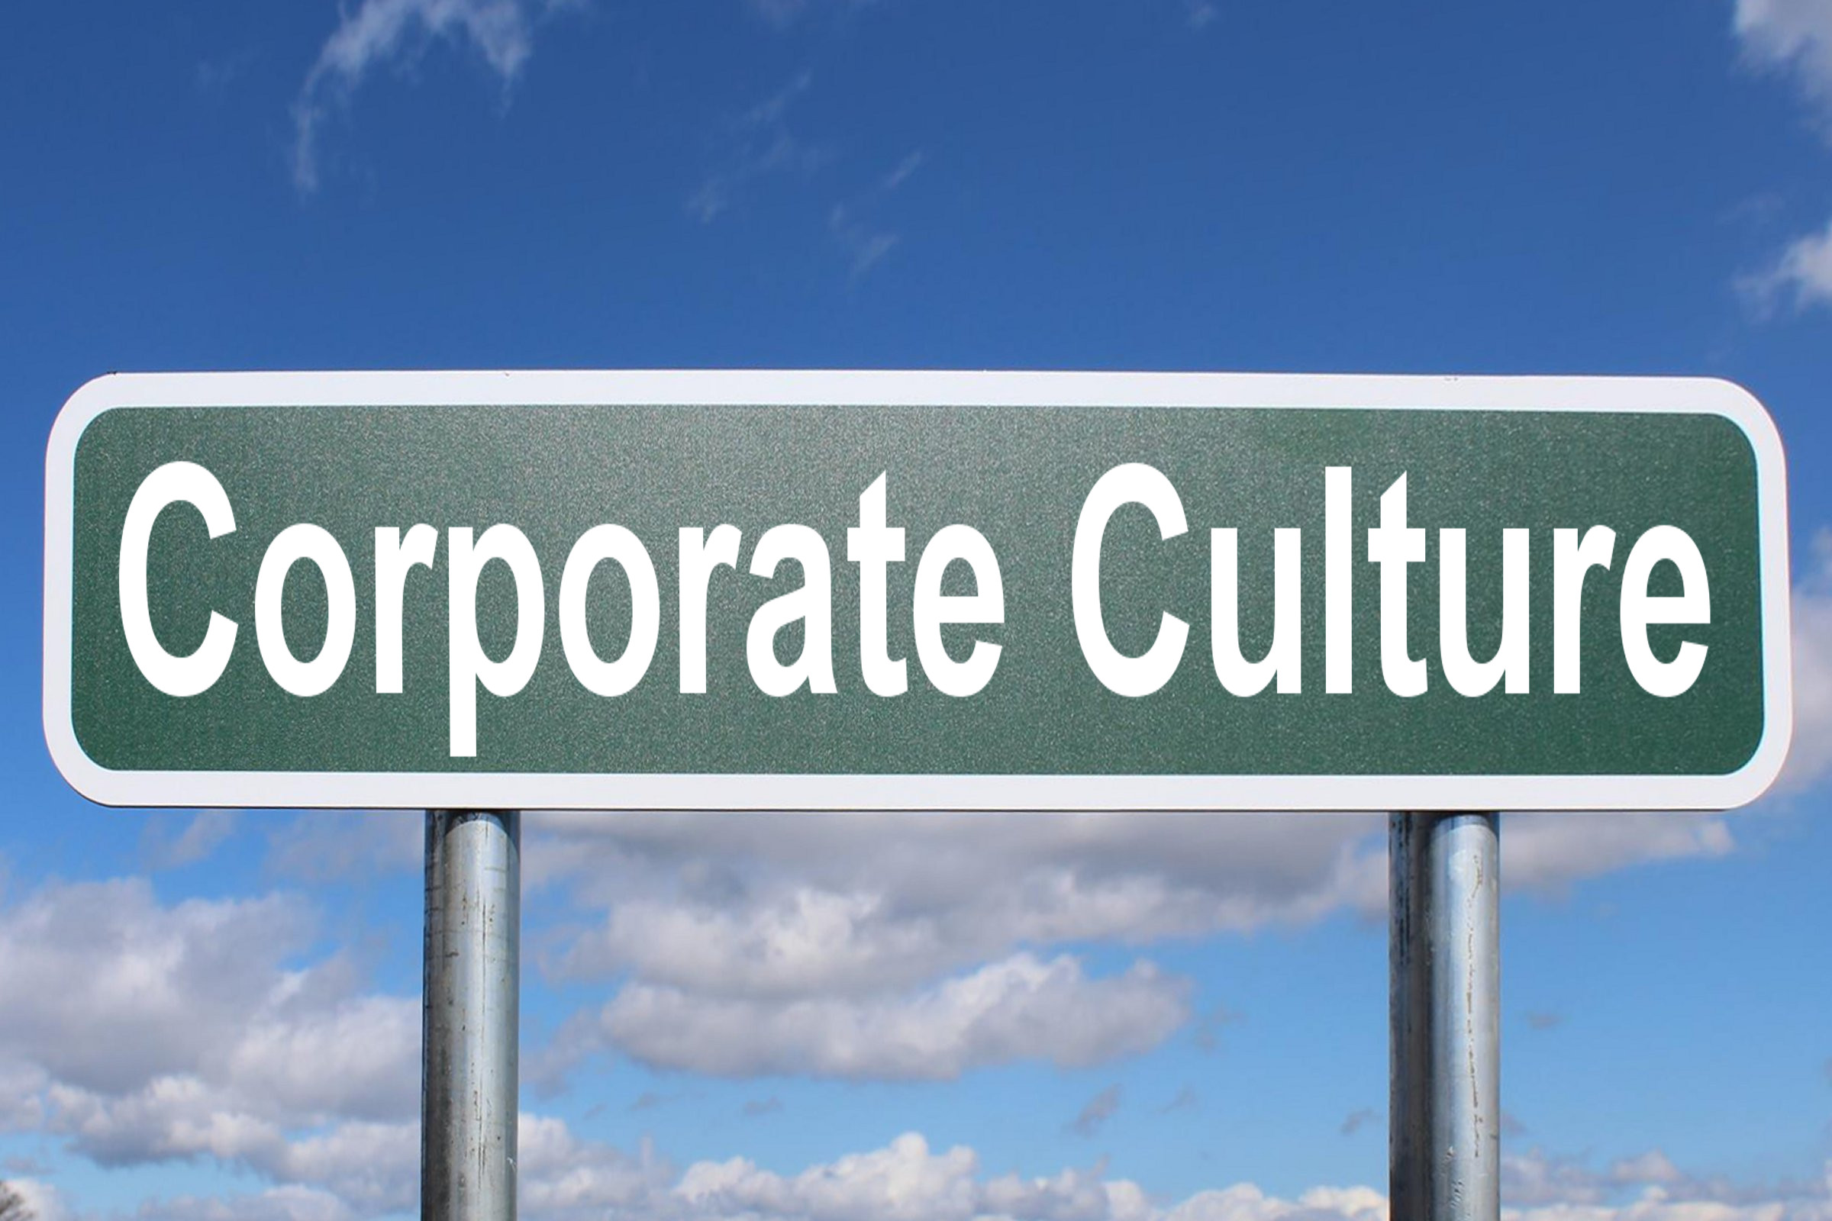

Which did you choose?

Slide 5
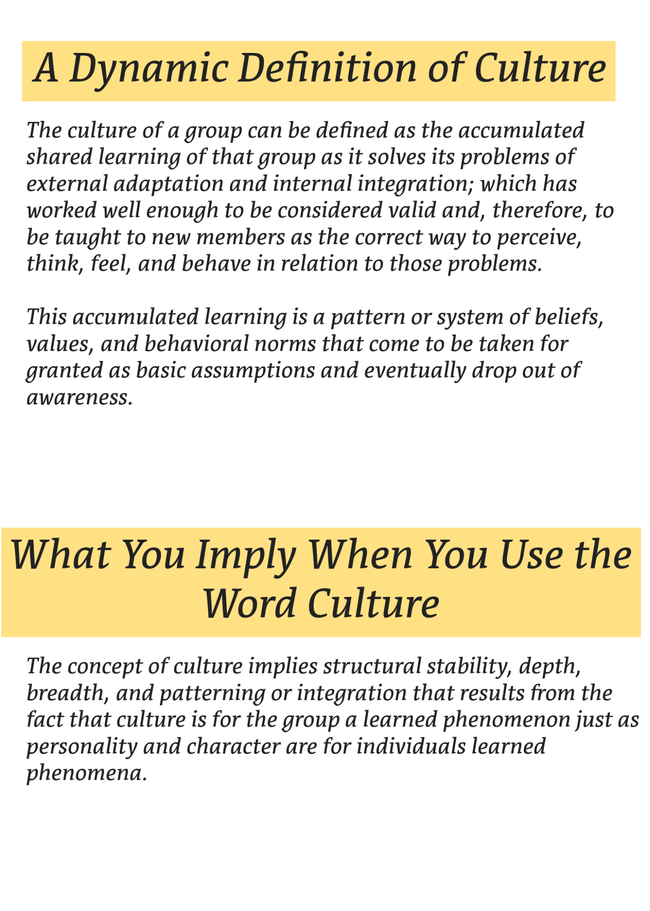

Slide 6
Corporate Culture
Artifacts
Espoused Beliefs and Values
Rationalizations

Slide 7

Artifacts
Beliefs
Rationalizations

Slide 8
Front Desk
Uniforms
Family Meal
“No” this “No” that
Mission/Vision
Team Work
Code of Conduct
Training
DEIB
Blame
Resistance to Change
Unethical OR Ethical

Slide 9
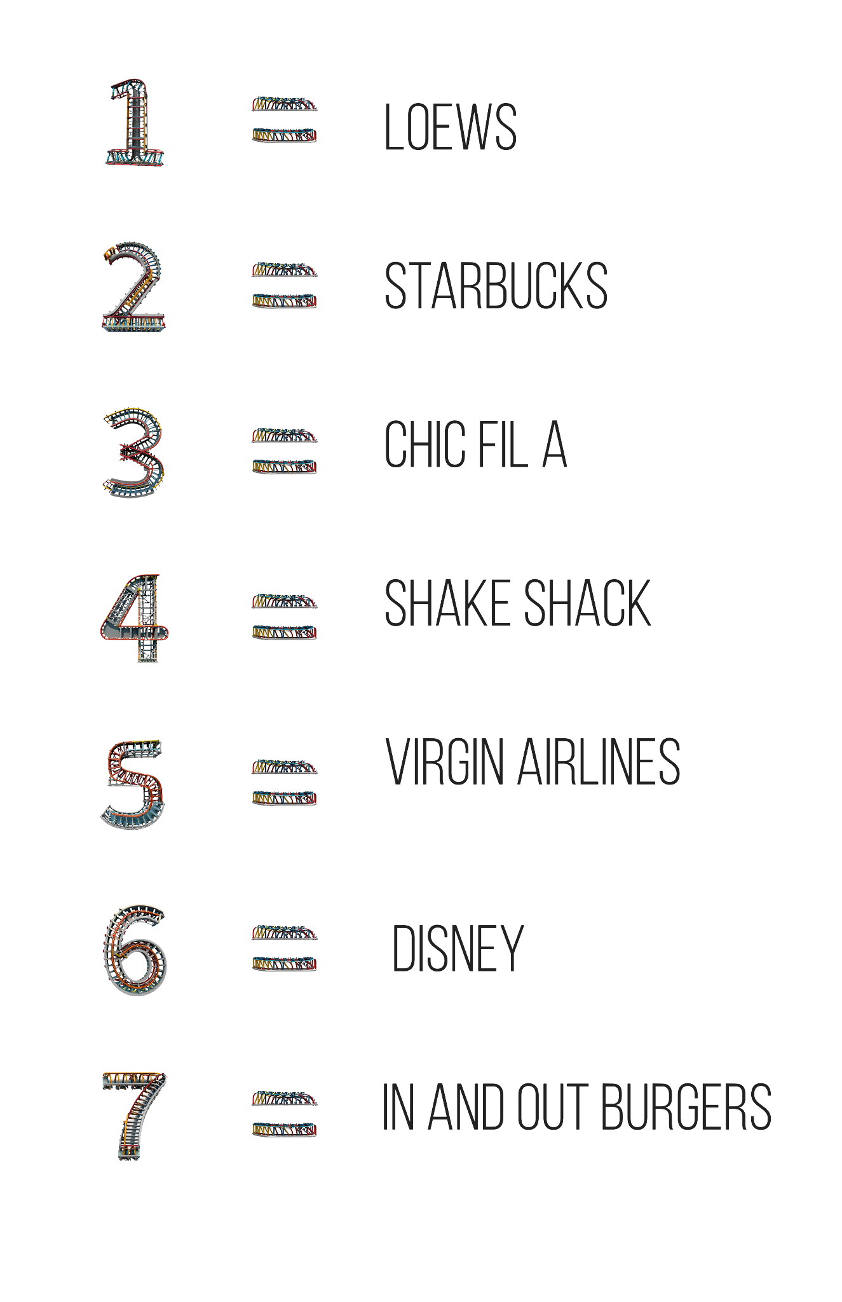
Now it is your turn
Numbers 1-7
Find your your group
Use the number = company
Do the following:
  Discuss what you THINK is their culture.
  Use your tools (web, phone, etc.) to look and see if you can find evidence of HOW their culture is seen from the (1) customer/guest and (2) employee.
  Use the sticky notes to identify Artifacts, Beliefs, Rationalizations.
  Place the sticky notes where you believe they belong.
  Be ready to talk about your findings with the group.

Slide 10

At Union Square Hospitality Group, our mission is to enrich lives through the power of Enlightened Hospitality. This unique approach puts our employees first because we believe that attracting, hiring, and nurturing the right people is what sets our businesses apart. We aim to find “51%ers”, individuals who embody our Family Values of Excellence, Hospitality, Entrepreneurial Spirit, and Integrity.
Danny Meyer
Founder & Executive Chairman

Slide 11
The 6 Keys to Hospitality Quotient
1. Optimistic warmth (genuine kindness, thoughtfulness, and a sense that the glass is always at least half full);
2. Intelligence (not just “smarts” but rather an insatiable curiosity to learn for the sake of learning);
3. Work ethic (a natural tendency to do something as well as it can possibly be done);
4. Empathy (an awareness of, care for, and connection to how others feel and how your actions make others feel);
5. Self-awareness (an understanding of what makes you tick
6. Integrity (a natural inclination to be accountable for doing the right thing with honesty and superb judgment).
Forbes.

Slide 12
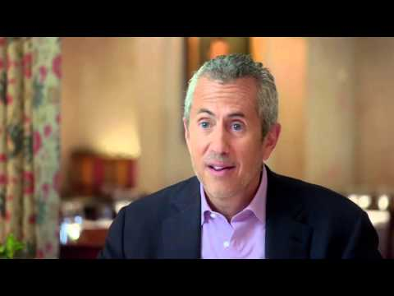

Slide 13
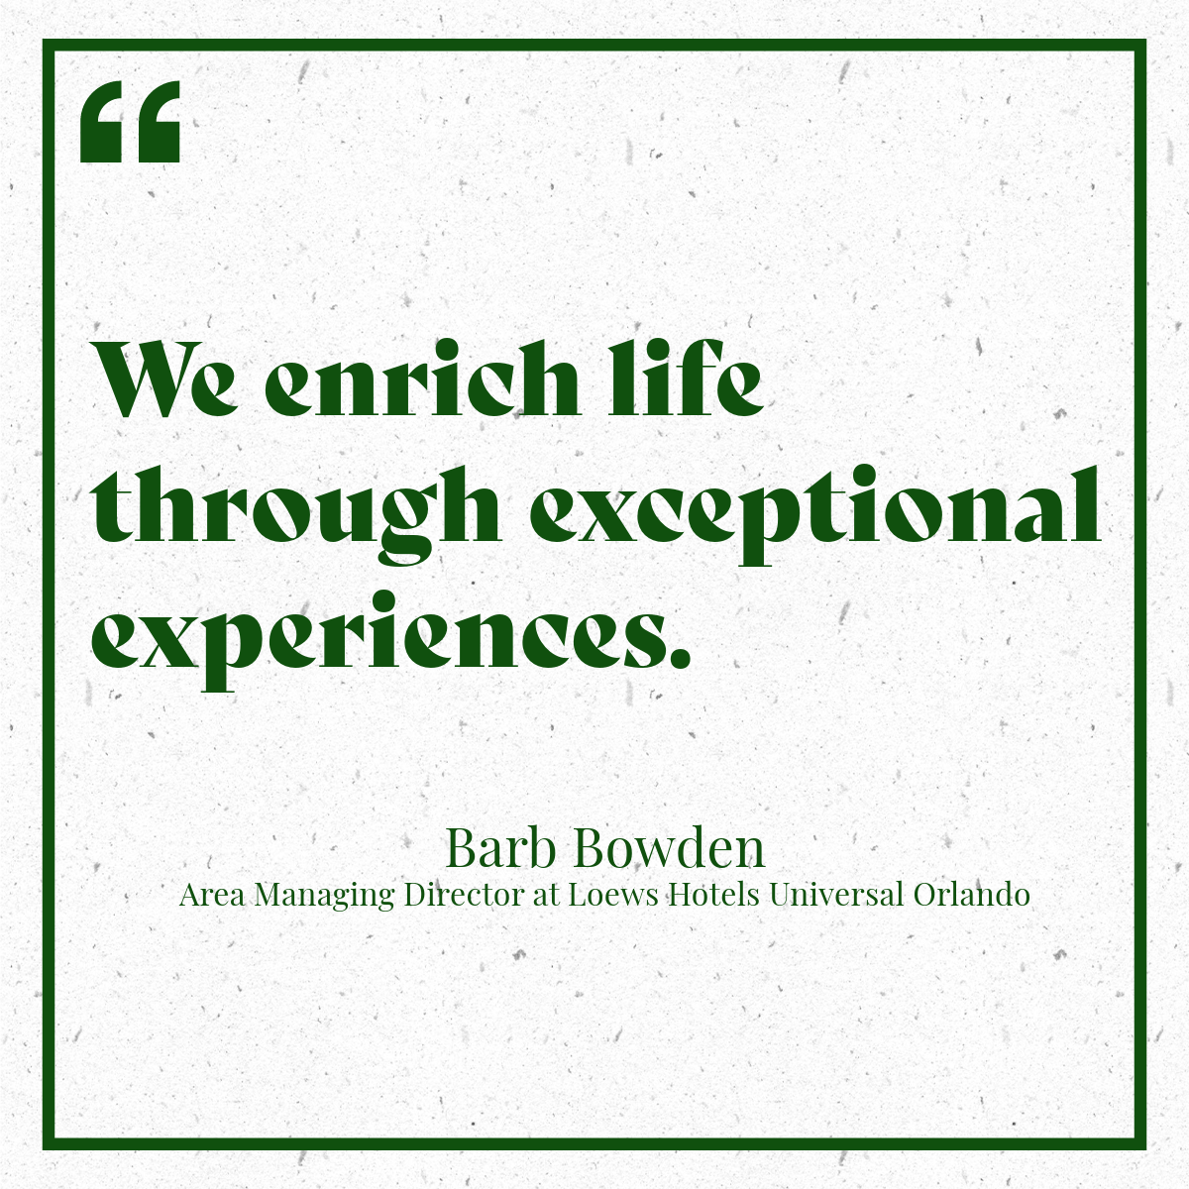
Notes:
https://frla.org/barbara-bowden-a-heart-for-hospitality-and-helping-others-along-the-way-womens-history-month/

Slide 14
Thank you Loews!
Amazing Culture.
Amazing Leadership.
Amazing Passion.
Barb Bowden, she is an inspiration for all of our future leaders to follow.
Notes:
https://frla.org/barbara-bowden-a-heart-for-hospitality-and-helping-others-along-the-way-womens-history-month/

Slide 15
